Slide 1
SQL Final Project
Project Title: Sales Performance Analysis of Walmart Stores Using Advanced MySQL Techniques

Slide 2
Introduction
Walmart, a major retail chain, operates across several cities, offering a wide range of products. The dataset provided contains detailed transaction data, including customer demographics, product lines, sales figures, and payment methods. This project will use advanced SQL techniques to uncover actionable insights into sales performance, customer behavior, and operational efficiencies.

Slide 3
Business Problem
Walmart wants to optimize its sales strategies by analyzing historical transaction data across branches, customer types, payment methods, and product lines. To achieve this, advanced MySQL queries will be employed to answer challenging business questions related to sales performance, customer segmentation, and product trends.

Slide 4
Task 1: Identifying the Top Branch by Sales Growth Rate (6 Marks) Walmart wants to identify which branch has exhibited the highest sales growth over time. Analyze the total sales for each branch and compare the growth rate across months to find the top performer.
/* Step1: Fetch monthly sales for each branch respectively. */
select Branch, DATE_FORMAT(Date, '%m-%Y') AS Month, SUM(Total) AS MonthlySales
from walmartsales
group by Branch, Month
order by Branch, Month;

Slide 5
/* step2: Find monthly growth rate for each branch respectively. */
/* We'll use the concept of CTE to make the query readable and modular. */
WITH Sales_Growth AS
(
select Branch, DATE_FORMAT(Date, '%m-%Y') AS Month, SUM(Total) AS Monthly_Sales,
LAG(SUM(Total)) OVER (PARTITION BY Branch ORDER BY DATE_FORMAT(Date, '%m-%Y')) AS Prev_Month_Sales
from walmartsales
group by Branch, Month
)

Slide 6
/* Check the status of Step2. */
select Branch, Month, Monthly_Sales, Prev_Month_Sales,
ROUND(((Monthly_Sales - Prev_Month_Sales) / Prev_Month_Sales) * 100, 2) AS Growth_Rate
from Sales_Growth
group by Branch, Month
order by Branch ASC;

Slide 7
/* Step3: We'll use the concept of CTE to make the query readable and modular. */
WITH Sales_Growth AS
(
select Branch, DATE_FORMAT(Date, '%m-%Y') AS Month, SUM(Total) AS Monthly_Sales,
LAG(SUM(Total)) OVER (PARTITION BY Branch ORDER BY DATE_FORMAT(Date, '%m-%Y')) AS Prev_Month_Sales
from walmartsales
group by Branch, Month
)

Slide 8
/* Step 4: Find the top branch using avg function for growth rate detection. */
select Branch, AVG( (Monthly_Sales - Prev_Month_Sales) / Prev_Month_Sales ) * 100 AS Avg_GrowthRate
from Sales_Growth
group by Branch
order by Avg_GrowthRate DESC
limit 1;

Slide 9
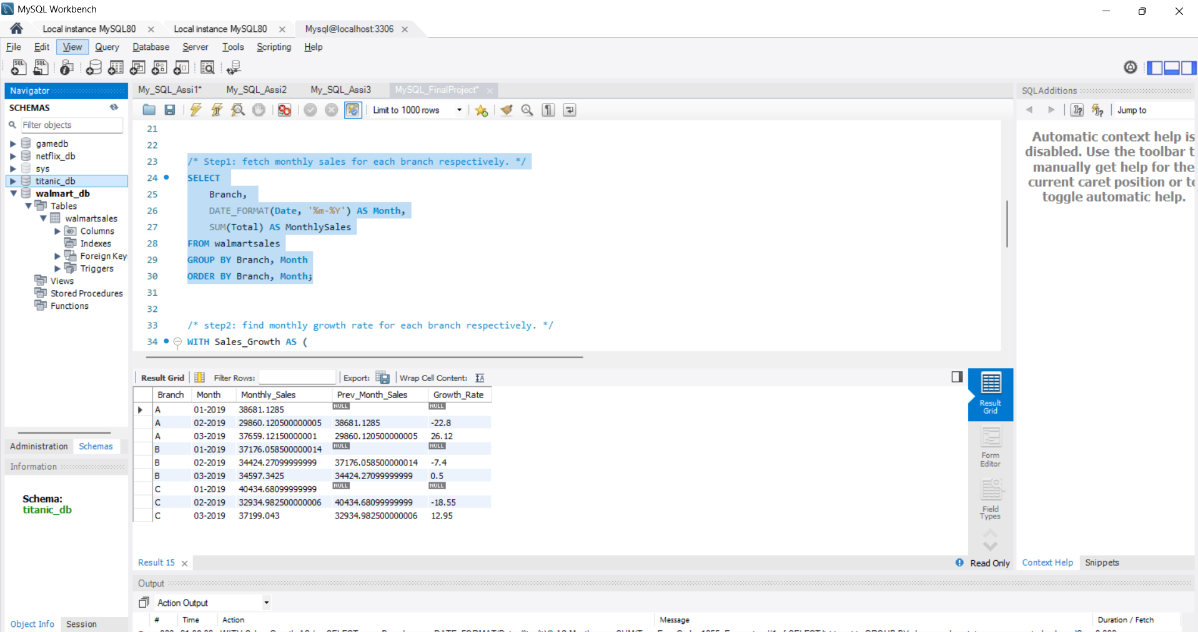

Slide 10
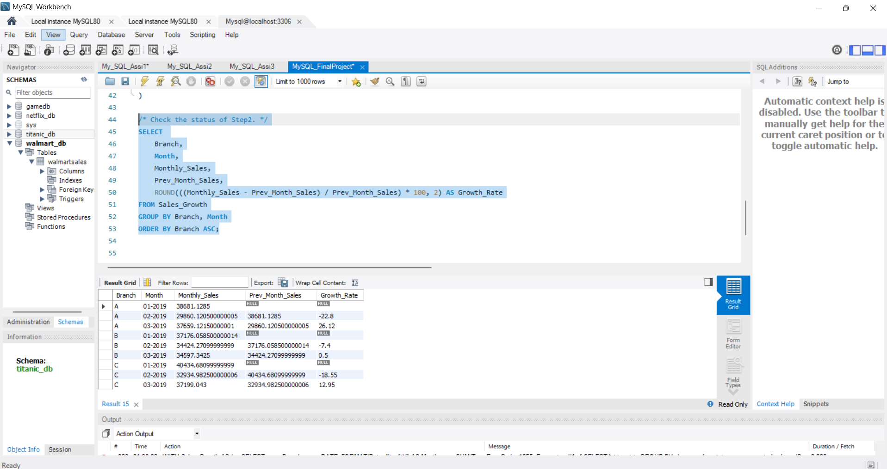

Slide 11
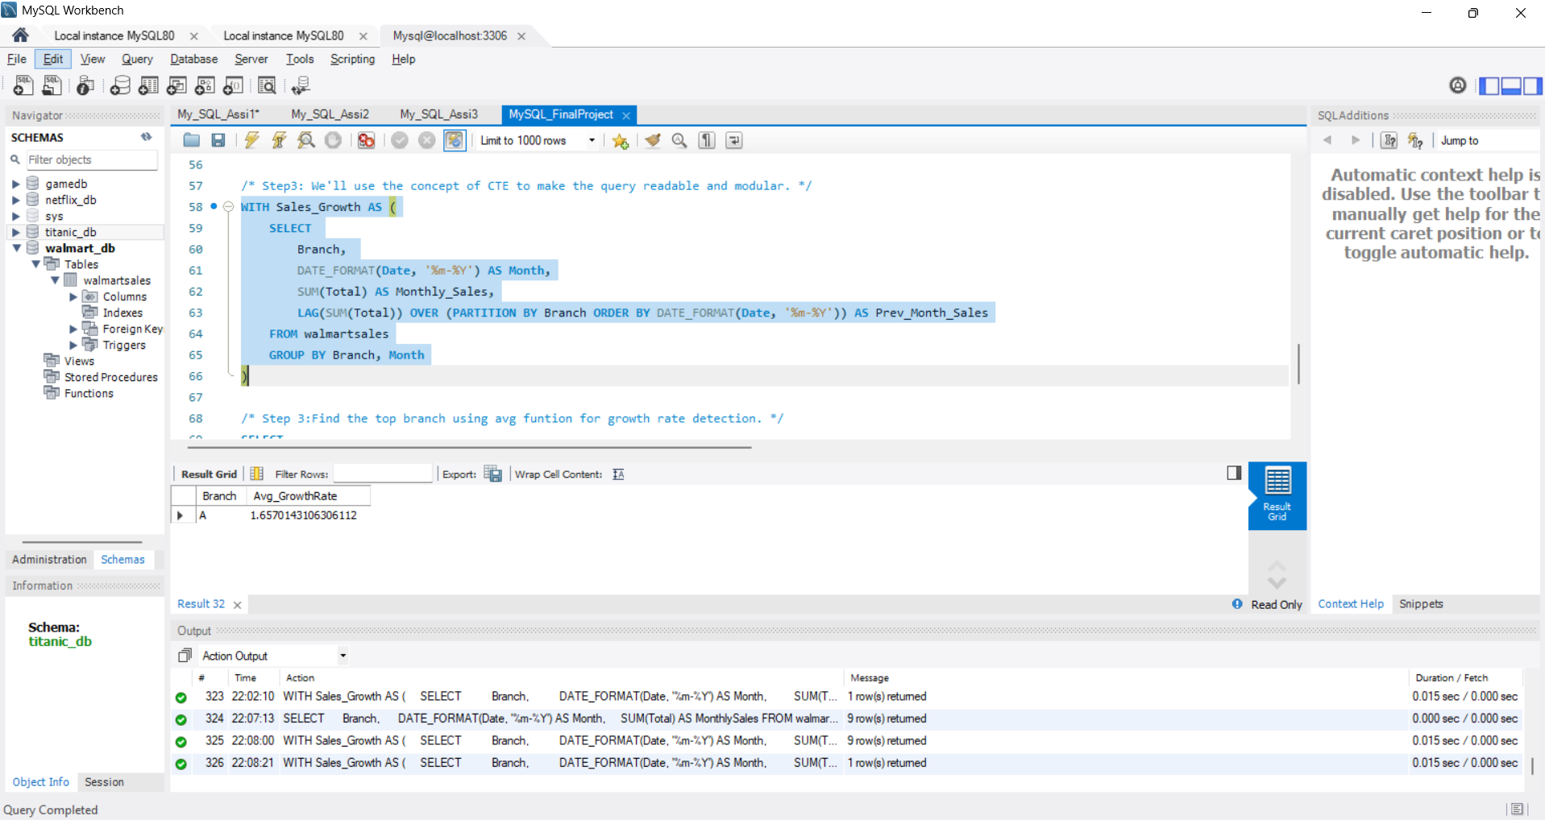

Slide 12
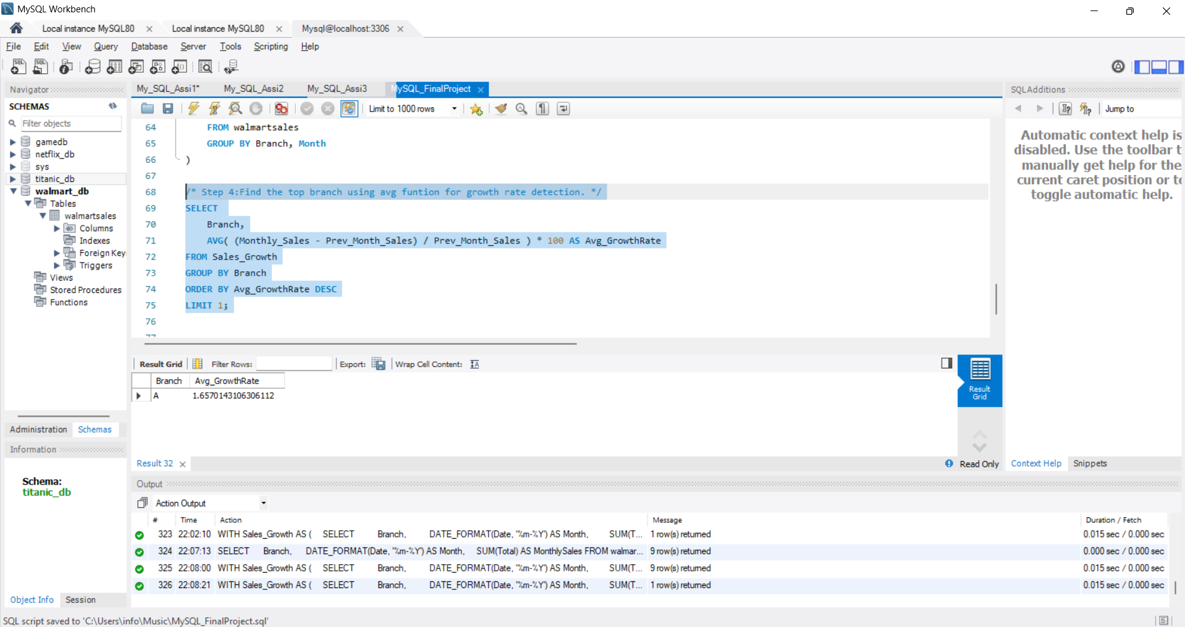

Slide 13
Task 2: Finding the most profitable Product Line for each Branch (6 Marks) Walmart needs to determine which product line contributes the highest profit to each Branch. The profit margin should be calculated based on the difference between the gross income and cost of goods sold.
/* Step1: use the concept of CTE and first compute the total profit. */
WITH Product_Profit AS
(
select Branch, Product_Line, SUM(Gross_Income - cogs) AS Total_Profit
from walmartsales
group by Branch, Product_Line
)

Slide 14
/* Step2: Fetch the most profitable Product Line for each branch. */
select pp.Branch, pp.Product_Line, pp.Total_Profit
from Product_Profit pp
JOIN
(
select Branch, MAX(Total_Profit) AS Max_Profit
from Product_Profit
group by Branch
) pm
/* Step3: show the joined result to return the top productline for each branch. */
ON pp.Branch = pm.Branch AND pp.Total_Profit = pm.Max_Profit
order by pp.Branch;

Slide 15
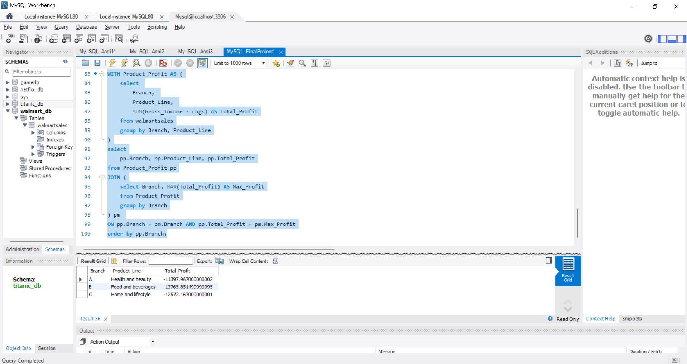

Slide 16
Task 3: Analyzing Customer Segmentation Based on Spending (6 Marks) Walmart wants to segment customers based on their average spending behavior. Classify customers into three tiers: High, Medium, and Low spenders based on their total purchase amounts.
/* Step1: using a CTE we will first fetch the total and average for the spendings for each customer. */
WITH Customer_Spendings AS
(
select `Customer ID` AS CustomerID, SUM(Total) AS Total_Spent, AVG(Total) AS Avg_Spent
from walmartsales
group by `Customer ID`
order by CustomerID

Slide 17
/* select * from Customer_Spendings; */
/* Step2: use the case and when segment to categorize the data as per the requirement. */
select CustomerID, Total_Spent, Avg_Spent,
CASE
when Avg_Spent < 300 then 'Low'
when Avg_Spent BETWEEN 301 AND 350 then 'Medium'
else 'High'
END AS Spending_Tier
from Customer_Spendings
order by Avg_Spent DESC;

Slide 18
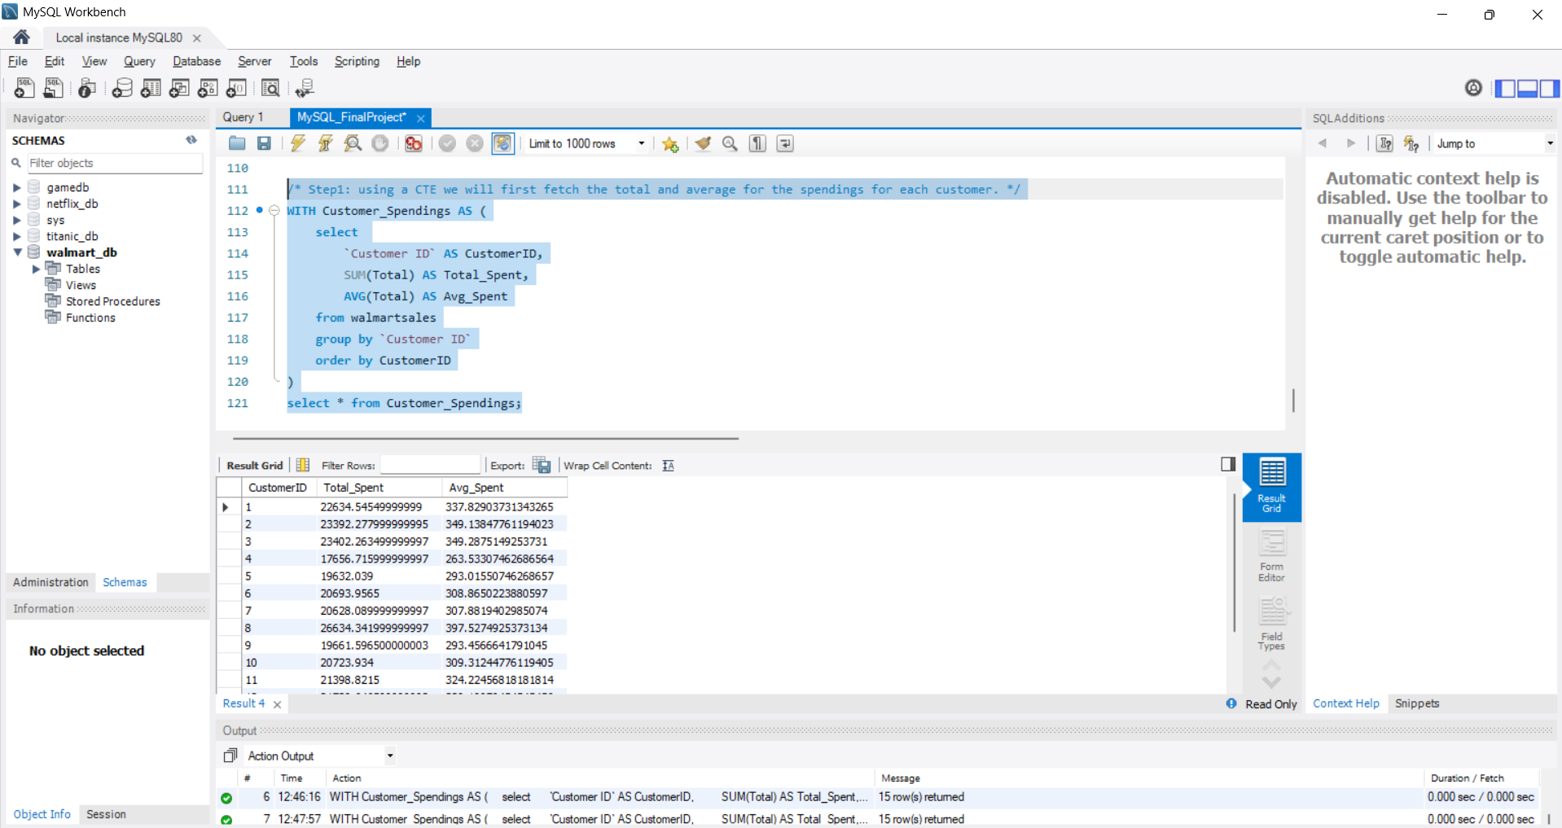

Slide 19
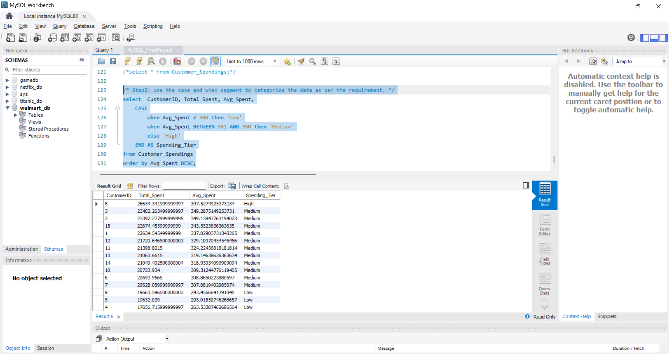

Slide 20
Task 4: Detecting Anomalies in Sales Transactions (6 Marks) Walmart suspects that some transactions have unusually high or low sales compared to the average for the product line. Identify these anomalies.
/* A common way to detect anomalies is by using the z-score method,
where: Z-score = (TransactionTotal - Mean) / StdDev
Any transaction with a z-score > 2 or < -2 is considered an anomaly. */
/* Let’s say for a specific ProductLine:
Average Total = 100Standard Deviation = 10
Now, for a transaction with Total = 150:z = 150−100/10 = 5
That’s a z-score of 5. 5 standard deviations above the mean. */

Slide 21
/*Step1: We first calculate the average and std deviation for the total. */
WITH ProductLine_Stats AS
(
select Product_Line, AVG(Total) AS Avg_Total, STDDEV(Total) AS StdDev_Total
from walmartsales
group by Product_Line
),
/* Step2: We calculate the Zscore for the total with respect to product line. */
Sales_WithZScore AS
(
select w.InvoiceID, w.Product_Line, w.Total, p.Avg_Total, p.StdDev_Total,
(w.Total - p.Avg_Total) / p.StdDev_Total AS ZScore
from walmartsales w
JOIN ProductLine_Stats p ON w.Product_Line = p.Product_Line
)

Slide 22
/* step3: Let's categorize the data of the found-out anomalies. */
select *,
CASE
when ZScore > 2 then 'High Anomaly'
when ZScore > 3 then 'Extreme High Anomaly'
when ZScore < -2 then 'Low Anomaly'
when ZScore < -3 then 'Extreme Low Anomaly'
else 'Normal Anomaly'
END AS Anomaly_Category
/* Step4: We select and check the outliers in our data. */
from Sales_WithZScore
/* ABS(ZScore) gives the absolute value, so both high and low extremes are caught. */
where ABS(ZScore) > 2
order by ZScore DESC;

Slide 23
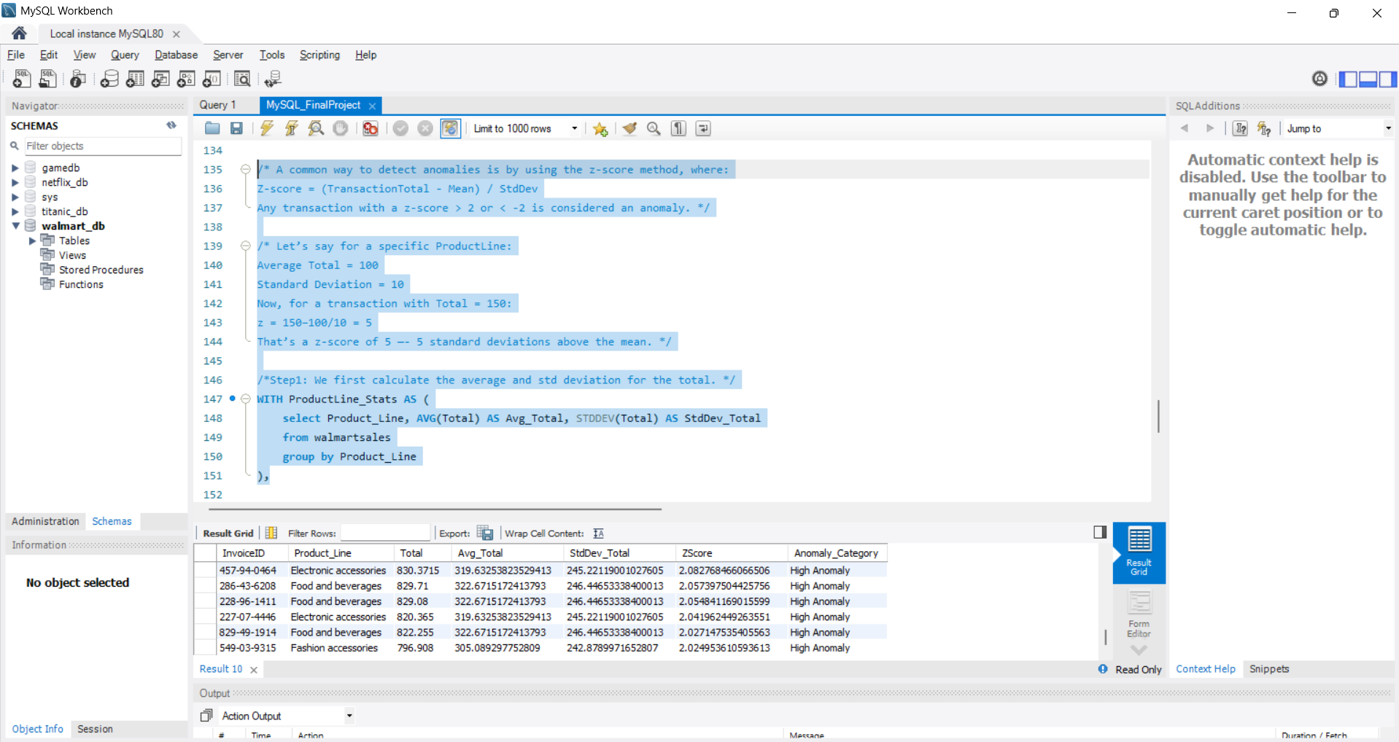

Slide 24
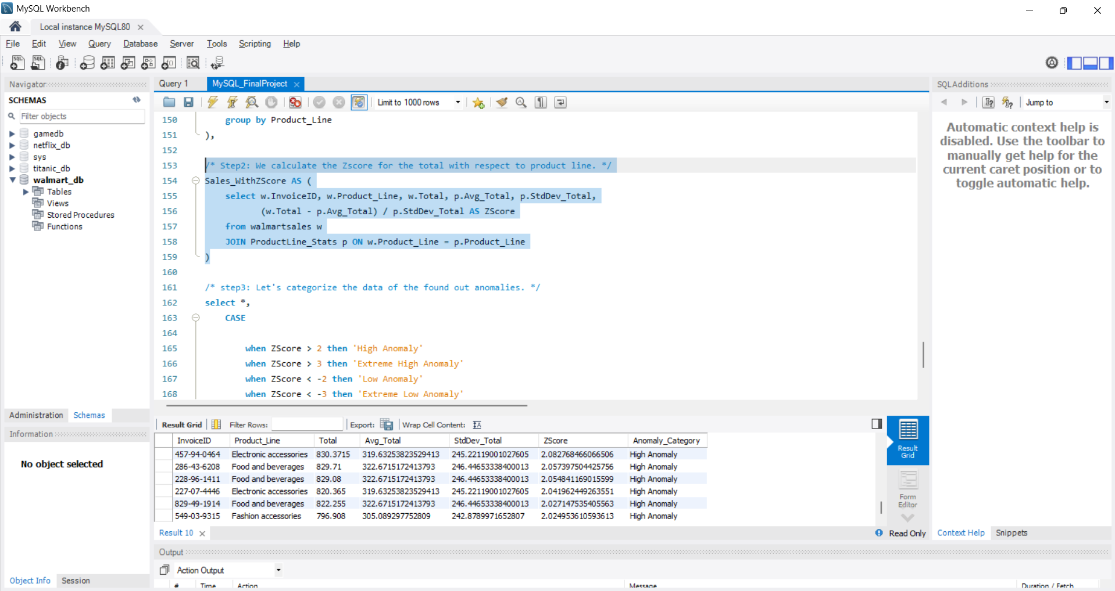

Slide 25
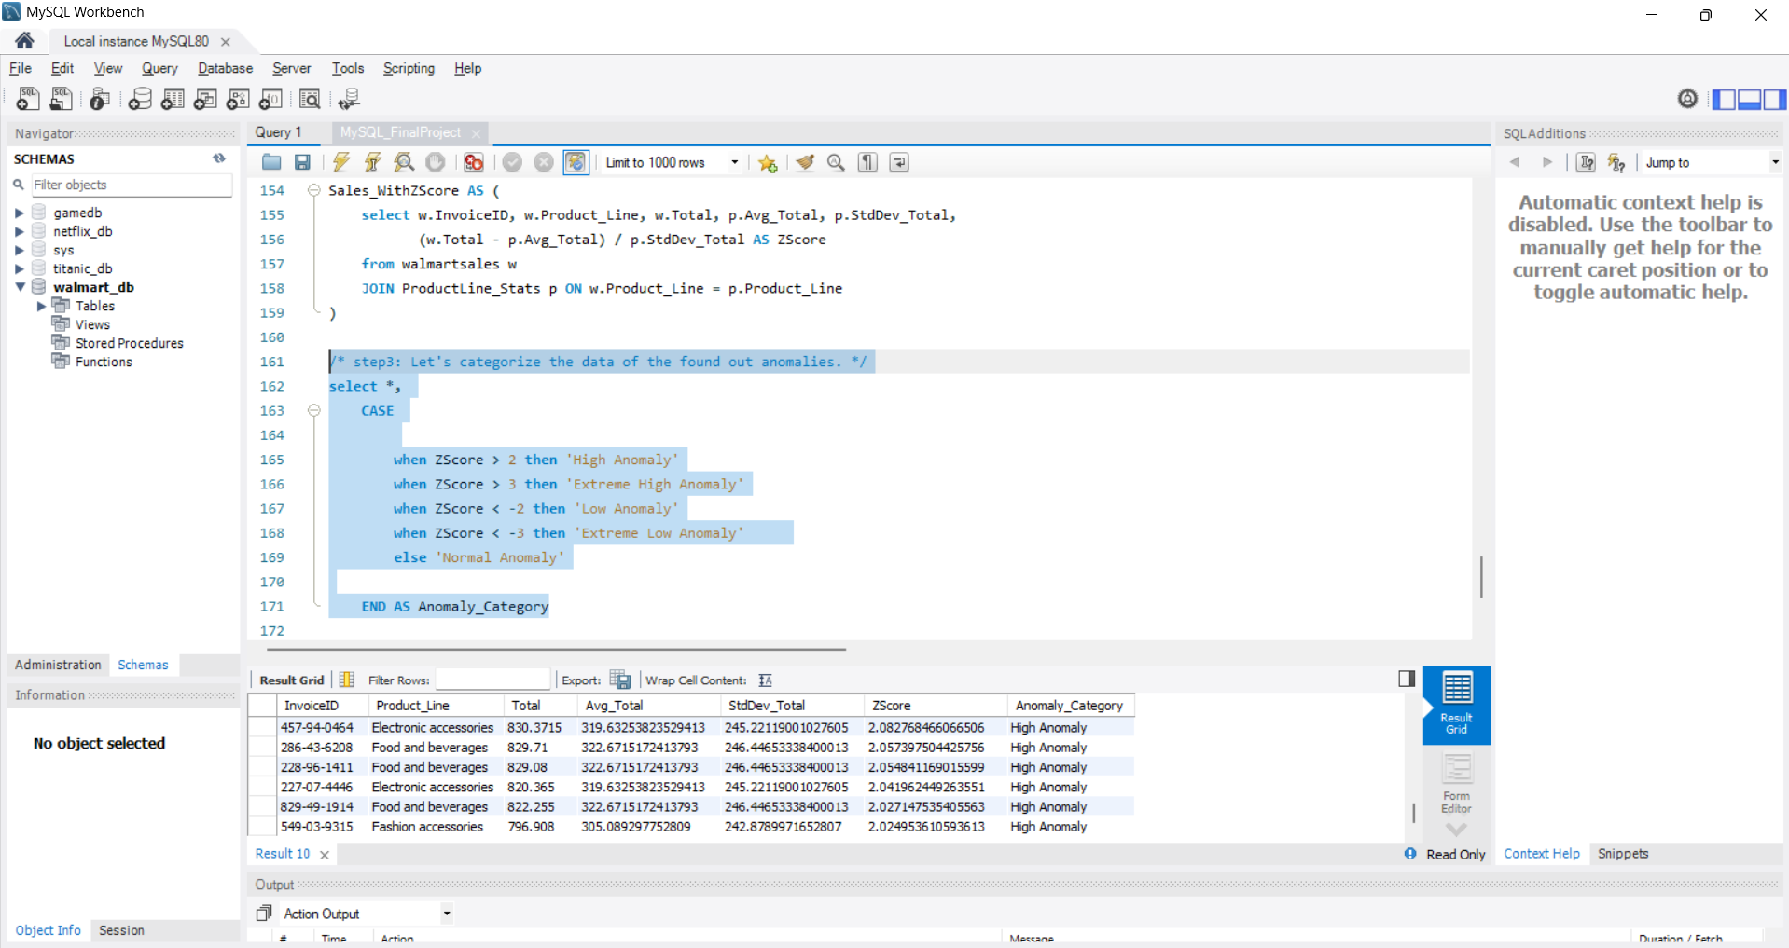

Slide 26
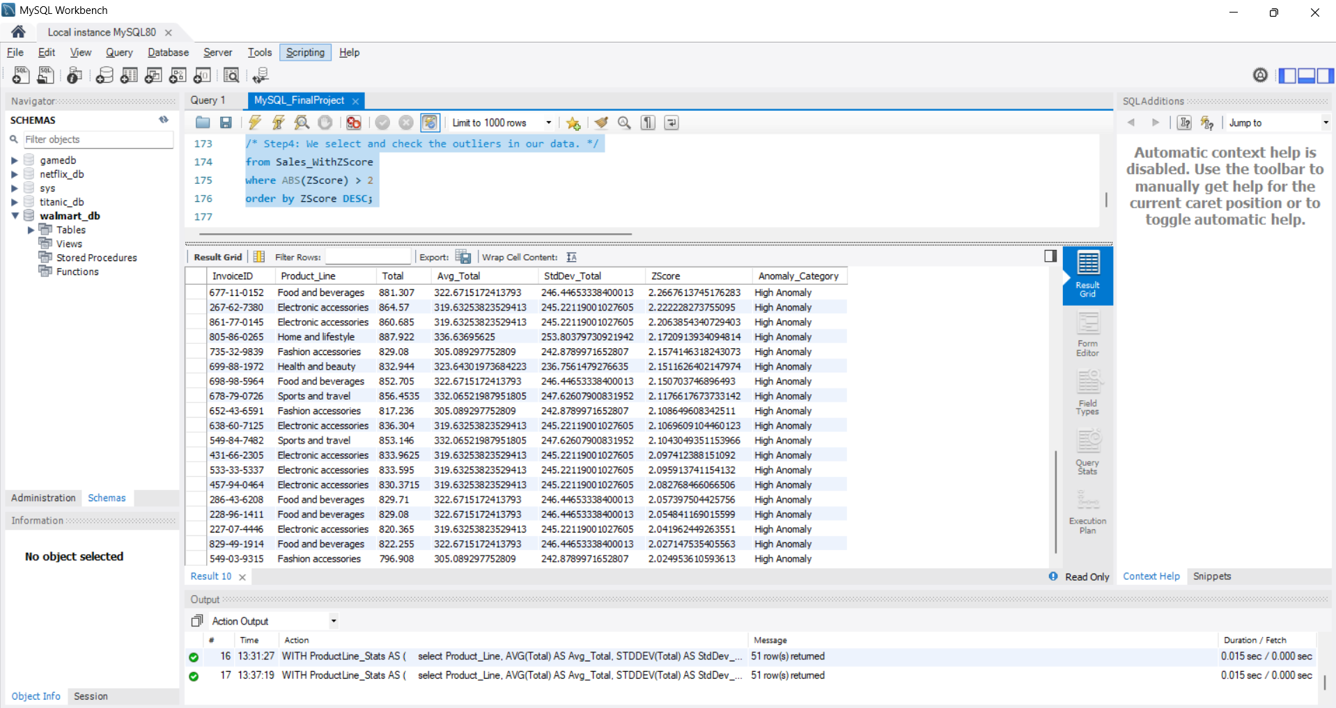

Slide 27
Task 5: Most Popular Payment Method by City (6 Marks) Walmart needs to determine the most popular payment method in each city to tailor marketing strategies.
/* Step1: We will check how many times each payment method was used in each city. */
WITH Payment_Counts AS
(
select City, Payment, COUNT(*) AS Payment_Count
from walmartsales
group by City, Payment
),

Slide 28
/* Step2: We will rank each payment method per city by their count. */
Ranked_Payments AS
(
select *, RANK() OVER (PARTITION BY City ORDER BY Payment_Count DESC) AS rk
from Payment_Counts
)
select City, Payment AS Most_Popular_Payment_Method, Payment_Count
from Ranked_Payments
/* We will filter only the top-ranked (most popular) payment method per city. */
where rk = 1
order by City;

Slide 29
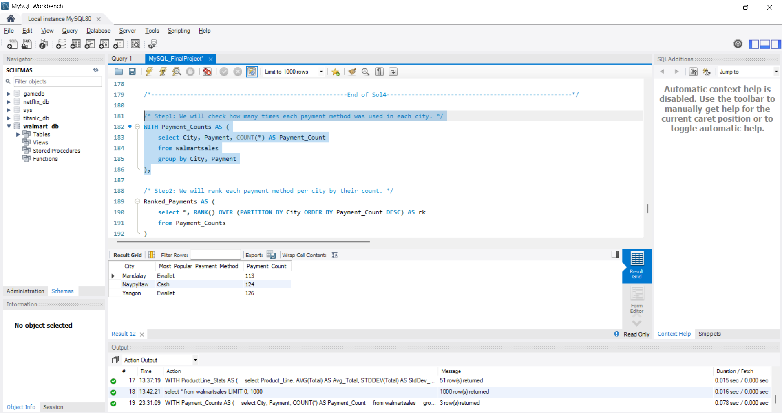

Slide 30
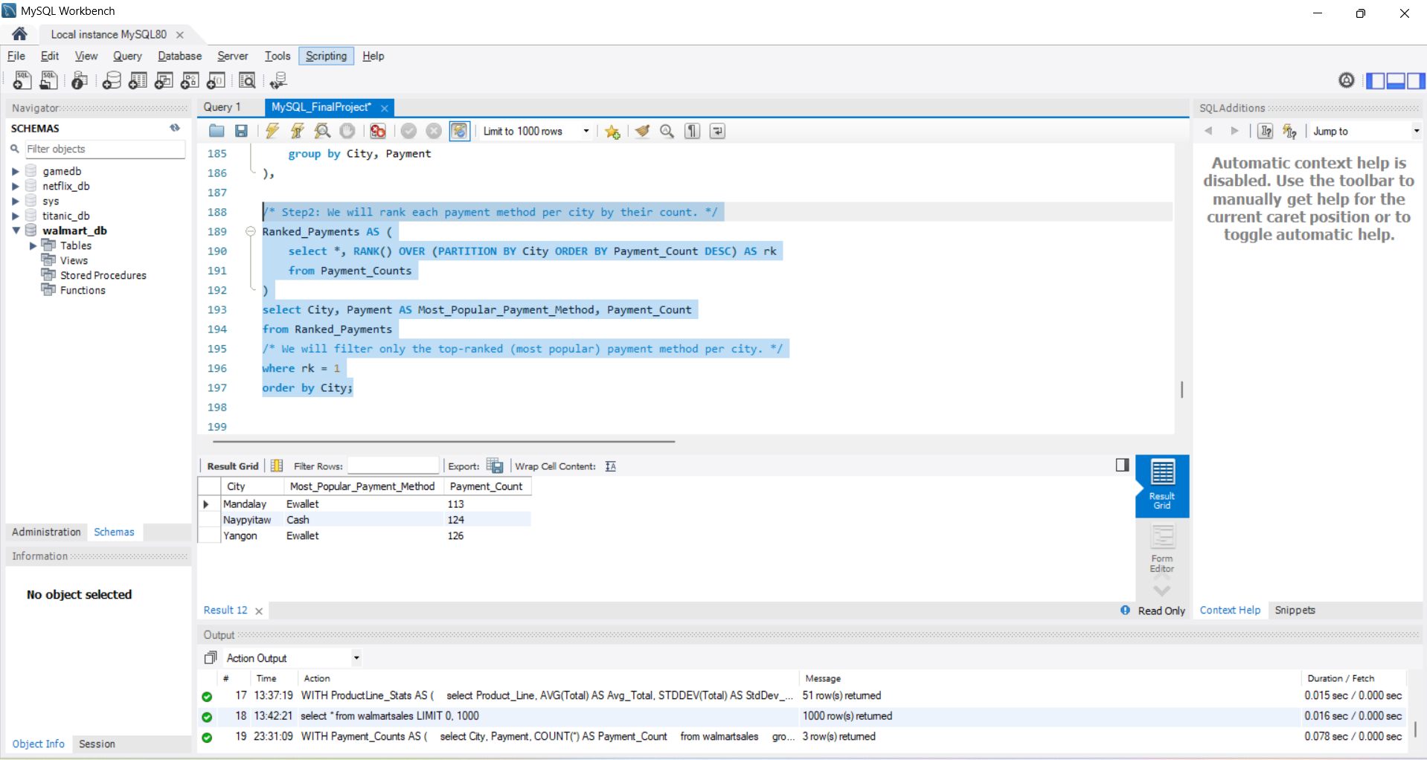

Slide 31
Task 6: Monthly Sales Distribution by Gender (6 Marks) Walmart wants to understand the sales distribution between male and female customers on a monthly basis.
WITH Monthly_Sales AS (
/* We will first extract Month and Year from the Date. */
select DATE_FORMAT(Date, '%m-%Y') AS Month, Gender, SUM(Total) AS Total_Sales from walmartsales
/* We will group by Month and Gender to sum up the Total Sales. */
group by Month, Gender
/* We will order the results chronologically for easy analysis. */
order by Month, Gender
)
select * from Monthly_Sales;

Slide 32
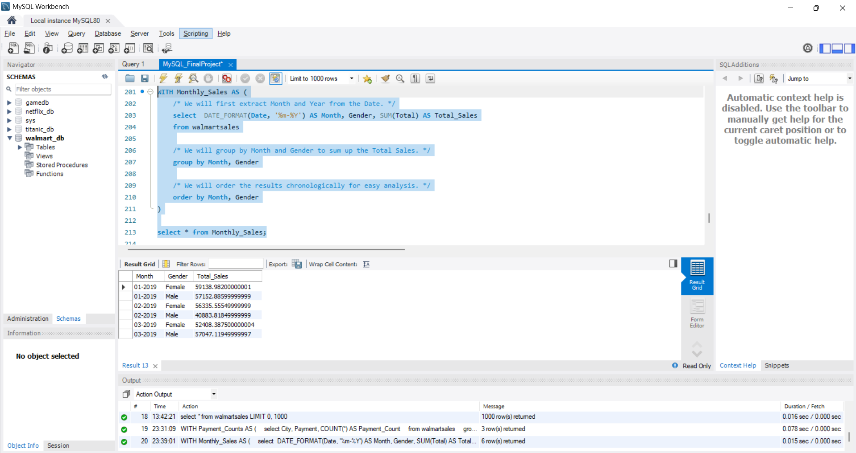

Slide 33
Task 7: Best Product Line by Customer Type (6 Marks) Walmart wants to know which product lines are preferred by different customer types(Member vs. Normal)
/* Step1: Using CTE, we will first calculate Total_Sales for each Product_Line grouped by CustomerType. */
WITH ProductLine_Sales AS
(
select CustomerType, Product_Line, ROUND(SUM(Total),4) AS Total_Sales
from walmartsales
group by CustomerType, Product_Line
),

Slide 34
/* Step2: We now rank the product lines by sales with respect to each customer type.*/
Ranked_ProductLines AS
(
select *, RANK() OVER (PARTITION BY CustomerType ORDER BY Total_Sales DESC) AS rk from ProductLine_Sales
)
/* Step3: We now select only the top-ranked(best) Product_Line per CustomerType. */
select CustomerType, Product_Line AS Best_Product_Line, Total_Sales
from Ranked_ProductLines
where rk = 1
order by CustomerType;

Slide 35
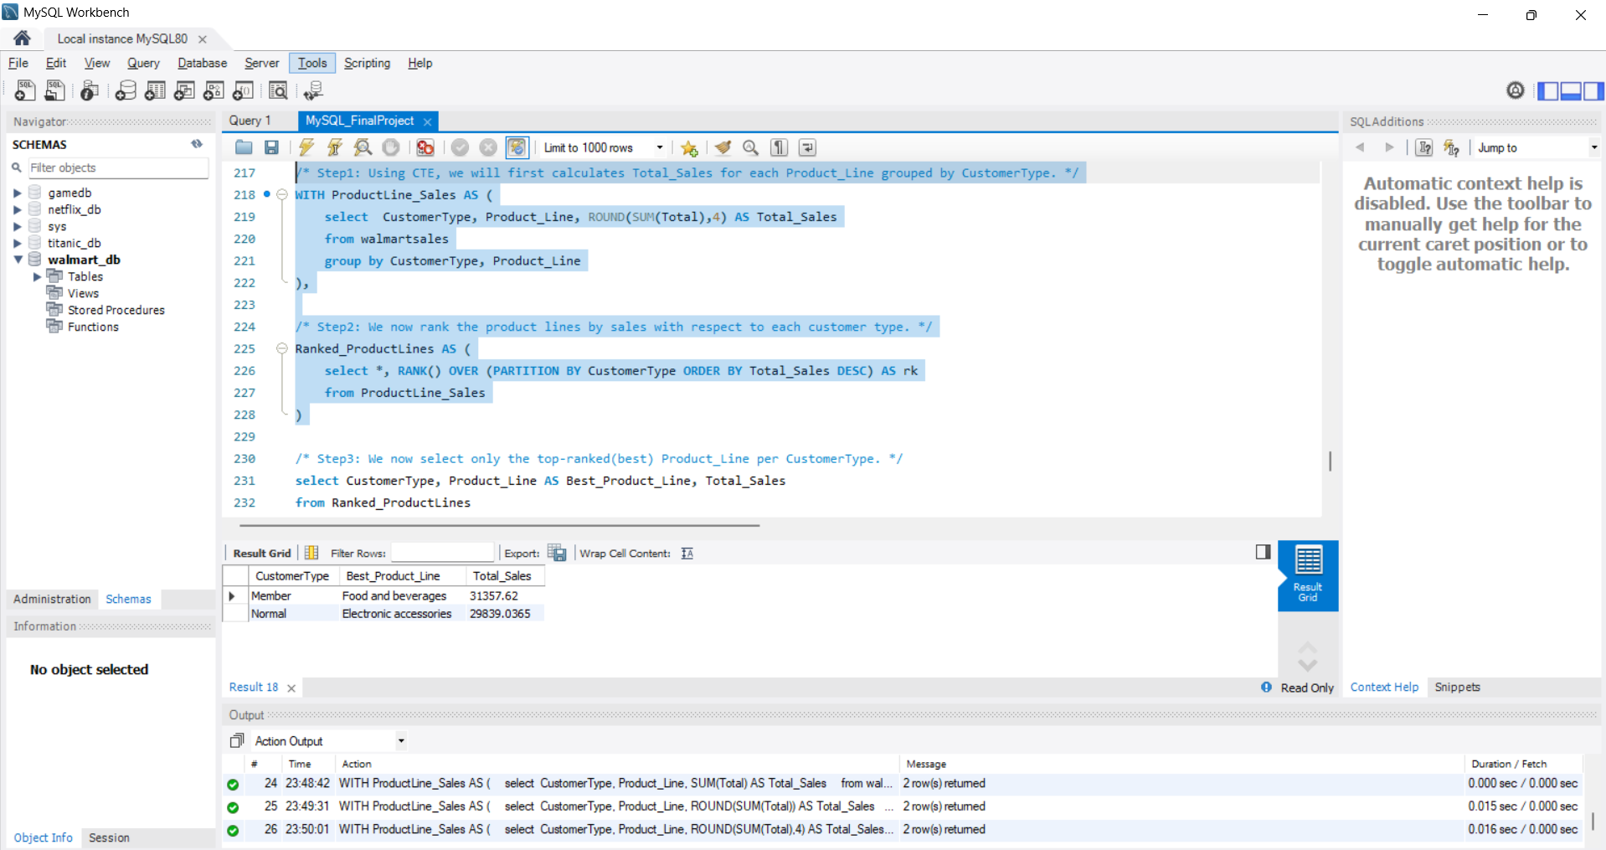

Slide 36
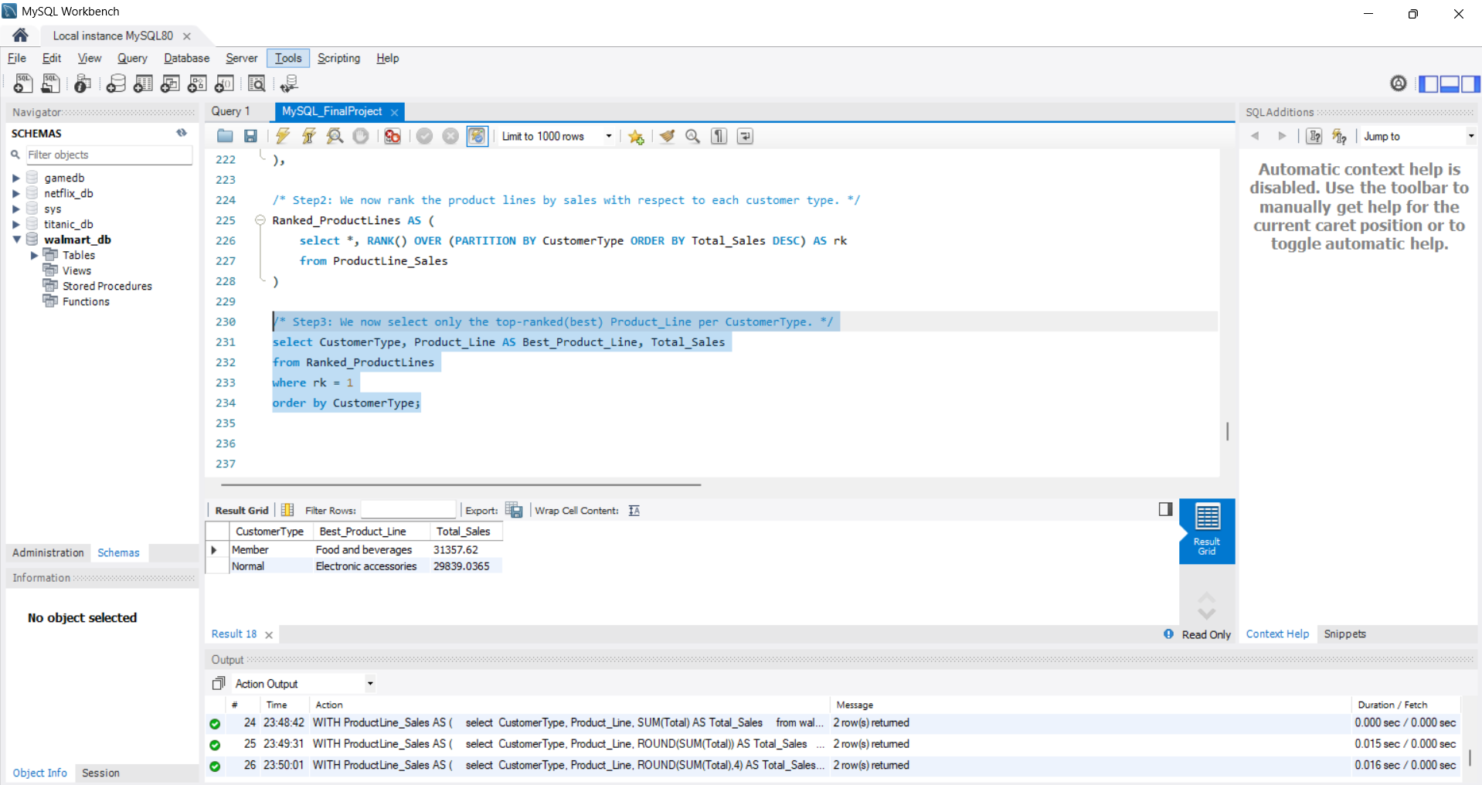

Slide 37
Task 8: Identifying Repeat Customers (6 Marks) Walmart needs to identify customers who made repeat purchases within a specific time frame (e.g., within 30 days).
/* Step1: We will first retrieve the next purchase date for each Customer ID using LEAD. */
WITH Customer_Purchases AS
(
select `Customer ID`, Date AS PurchaseDate,
LEAD(Date) OVER (PARTITION BY `Customer ID` ORDER BY Date) AS Next_PurchaseDate
from walmartsales
)

Slide 38
/* Step2: We now calculate the number of days between purchases for each Customer ID. */
select `Customer ID`, PurchaseDate, Next_PurchaseDate,
DATEDIFF(Next_PurchaseDate, PurchaseDate) AS Days_Between_Purchases
from Customer_Purchases
/* We need to filters for the customers who made another purchase within 30 days. */
where DATEDIFF(Next_PurchaseDate, PurchaseDate) <= 30
order by `Customer ID`, PurchaseDate;

Slide 39
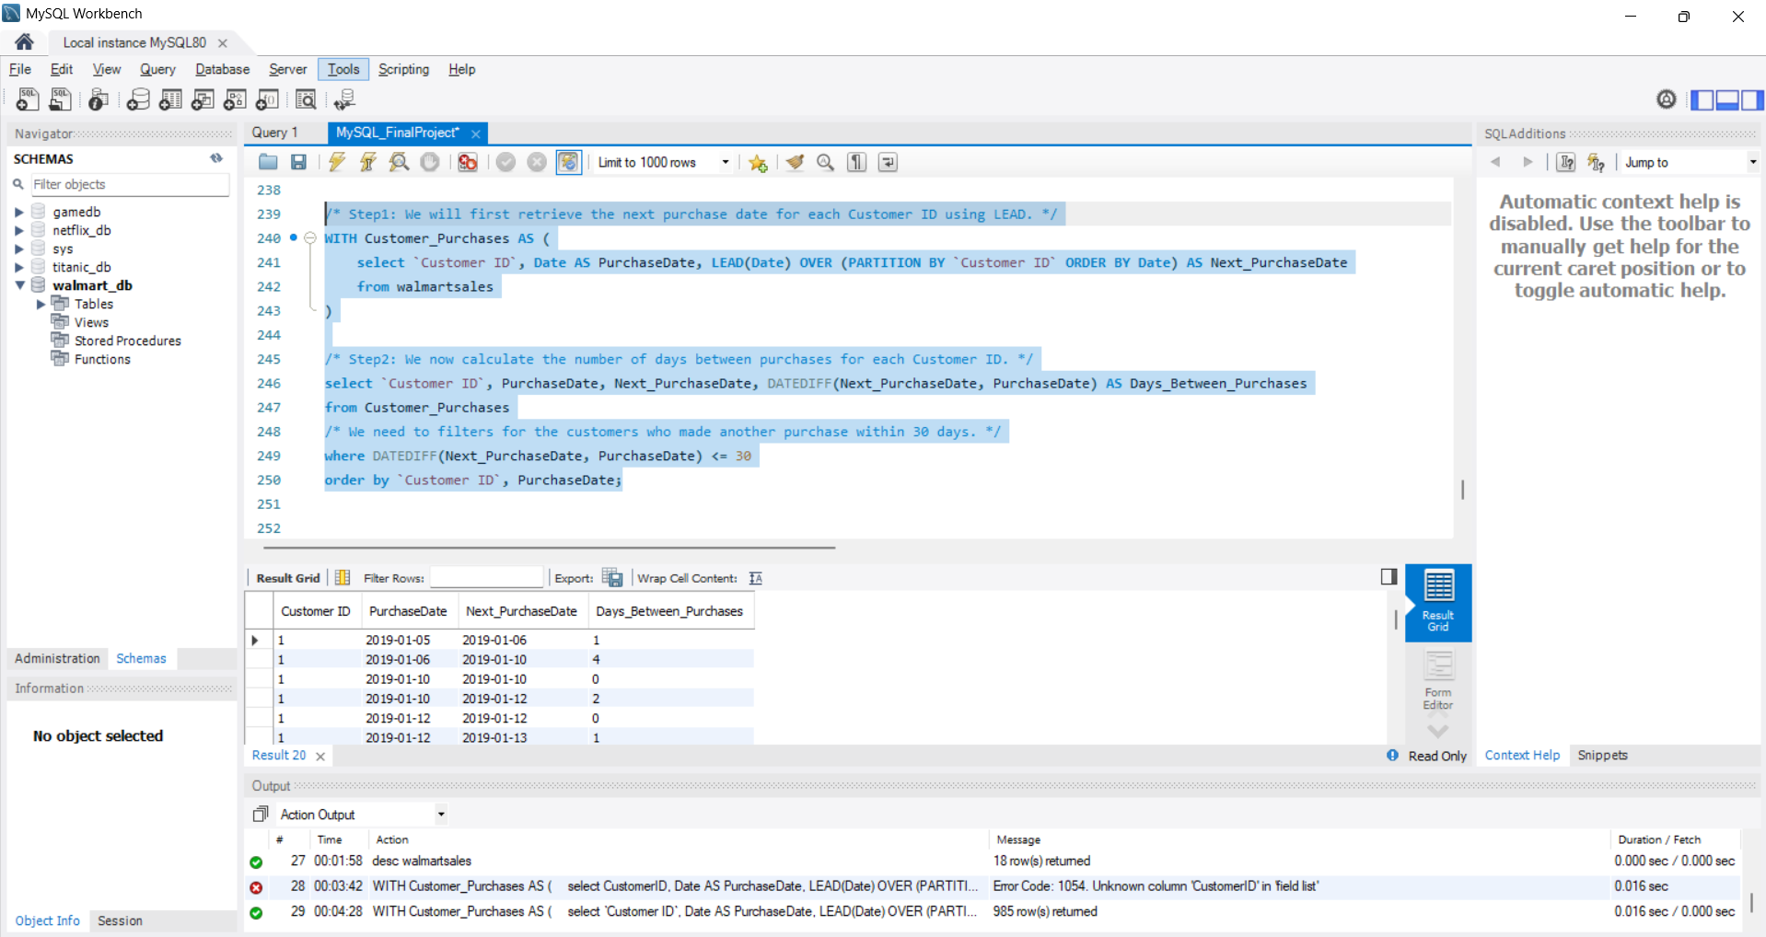

Slide 40
Task 9: Finding Top 5 Customers by Sales Volume (6 Marks) Walmart wants to reward its top 5 customers who have generated the most sales Revenue.
/* Step1: We need to first calculate the total sales revenue per customer. */
select `Customer ID`, ROUND(SUM(Total), 2) AS Total_Salesfrom walmartsales
/* Step2: We will group sales by each customer. */
group by `Customer ID`
/* Step3: We now sort the customers from highest to lowest with respect to revenue generated from them. */
order by Total_Sales DESC
/* Step4: We will retrieve only the top 5 customers using LIMIT. */
limit 5;

Slide 41
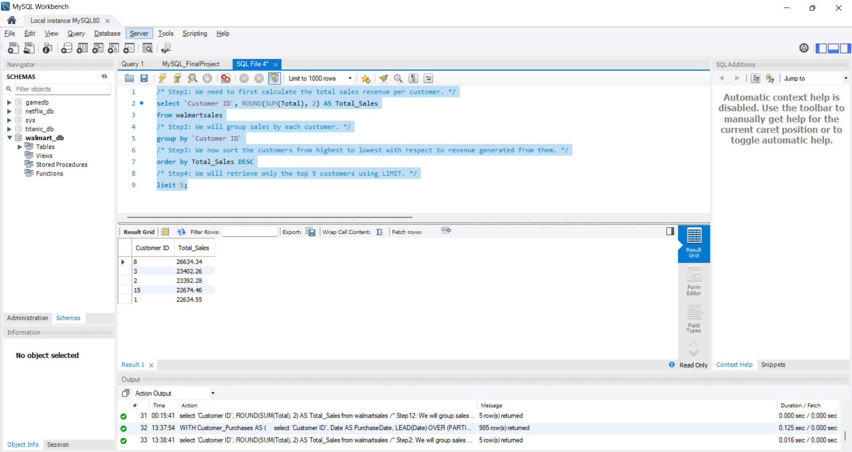

Slide 42
Task 10: Analyzing Sales Trends by Day of the Week (6 Marks) Walmart wants to analyze the sales patterns to determine which day of the week brings the highest sales.
/* Step1: We first extract the day of the week from the entire date. */
select DAYNAME(Date) AS Day_of_Week, ROUND(SUM(Total), 2) AS Total_Sales
from walmartsales
/* Step2: We will group sales by each weekday. */
group by Day_of_Week
/* Step3: Finally, we sort the results from highest to lowest with respect to the sales. */
order by Total_Sales DESC;

Slide 43
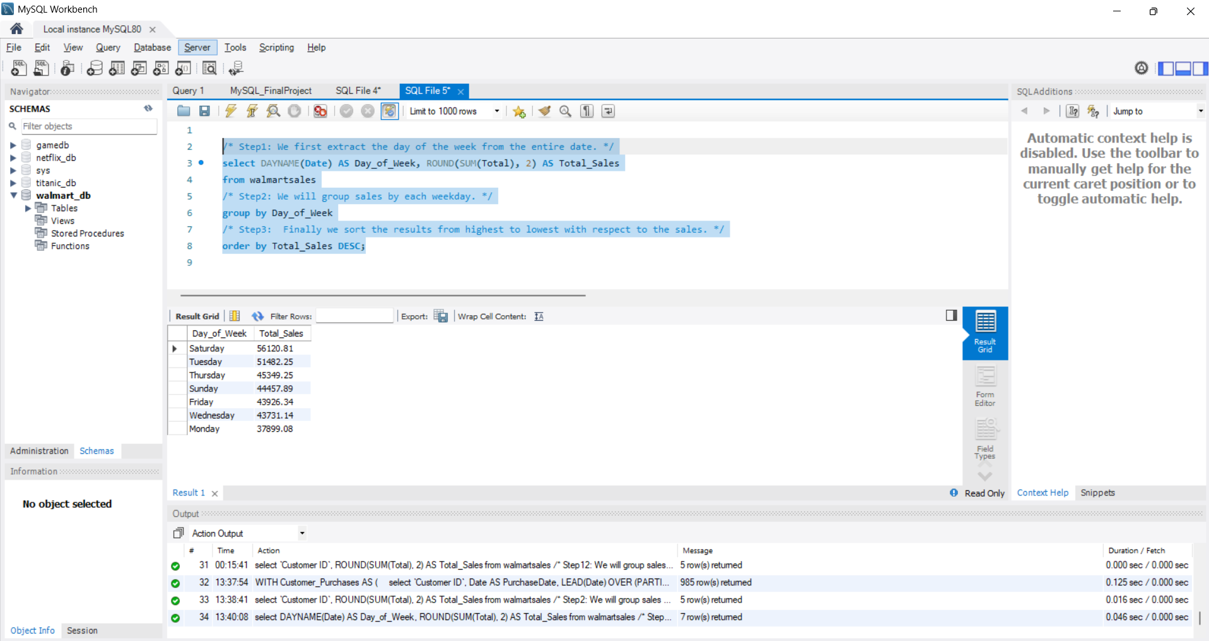

Slide 44
My video for this project analysis:
https://drive.google.com/file/d/1-mqFjoXOjB9CKrDfbmj0rTx9gt4BG0FC/view?usp=sharing

